Slide 1
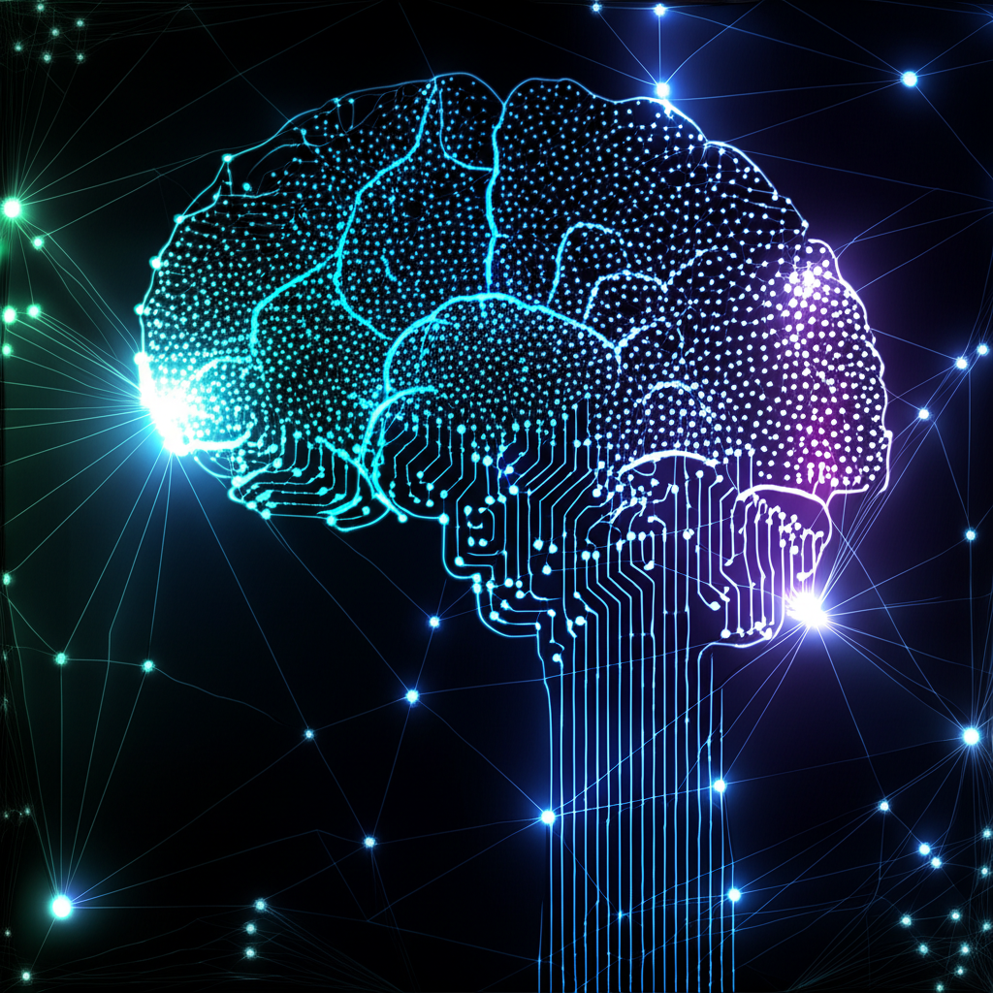
Artificial Intelligence: Exploring Its Dual Impact
Understanding the Advantages and Disadvantages of AI
This presentation delves into the multifaceted world of Artificial Intelligence, aiming to provide a balanced perspective on its transformative power. We will explore the significant benefits AI brings to various sectors, from enhanced efficiency to groundbreaking innovation, while also addressing the critical challenges and potential drawbacks that accompany its rapid development and deployment. Understanding both sides is crucial for responsible AI integration.

Slide 2

The Dual Edge of AI: Advantages vs. Disadvantages
Enhanced Efficiency & Automation
Improved Decision Making & Accuracy
Personalized Experiences & Services
Innovation & Complex Problem Solving
Accessibility & Inclusivity Features
Job Displacement & Reskilling Needs
Ethical Concerns & Algorithmic Bias
Data Privacy & Security Risks
Complexity & High Implementation Costs
Lack of Human Intuition & Empathy

